Slide 1
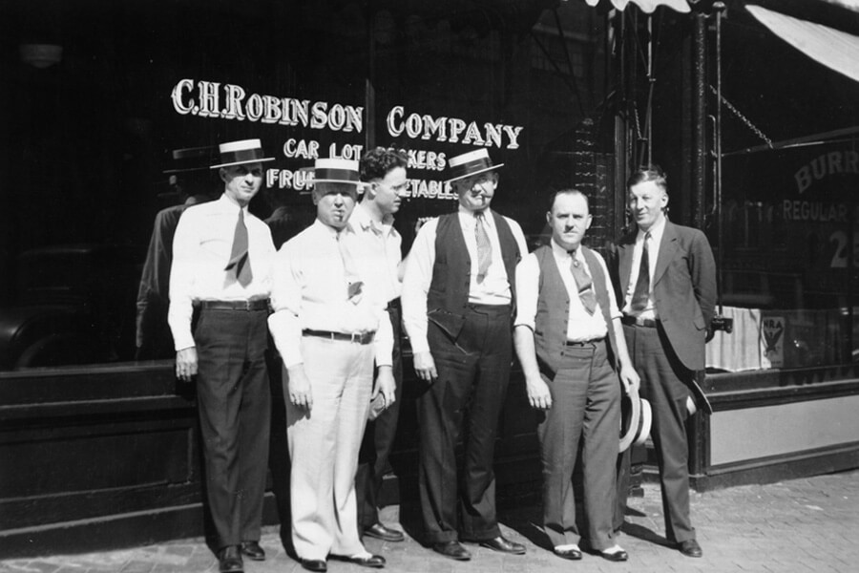
Buggy & Carriage to the Modern Digital Highway:
Advanced Analytics and Data Science @ CH Robinson
Tim Gagnon, Mark Albrecht

Slide 2
Agenda
3PLs & CH Robinson
Data Science 101…
Algorithms => Decision Support Systems
Team/Roles
Industry Trends
Data Science Strategy & Applications @ CH Robinson
Variety Hour: Working with Twitter API & Streaming

Slide 3


WHO WE ARE
$13.1B
INBOUND LOGISTICS
A TOP 3PL
^{TOTAL GROSS}
Our people, processes, and technology set us apart
^{REVENUE}
1998 – 2017
^{OVER}
113K
112 years of innovation and still shaping the future
#212 ON
^{CUSTOMERS}
^{FORTUNE}
107K
500
Global services company with over 14,000 employees across 39 countries on 5 continents
^{CARRIERS}
^{AND SUPPLIERS} ^{UNDER CONTRACT}

Slide 4
WHAT WE DO FOR OUR CUSTOMERS
We create transportation and supply chain advantages
DRIVE COSTS DOWN
IMPROVE EFFICIENCY
MITIGATE RISK
MANAGE CHANGE

Slide 5

We deliver an average of
3 services per top 500 customer
46%
^{OVER}
113K
26%
^{CUSTOMERS}
13%
Top 25
Top 100
Top 500
Diversified Customer Portfolio

Slide 6






CAPACITY RELATIONSHIPS WITH OVER 100 LTL CARRIERS
EXTENSIVE INTERMODAL COVERAGE WITH DIRECT ACCESS TO ALL Class 1 NORTH AMERICAN RAILROADS
TOP 10 NVOCC WITHIN THE GLOBAL OCEAN CARRIER PORTFOLIO
20 CORE AIR CARRIERS MOVE 72% OF OUR VOLUME
ROBINSON FRESH
MORE THAN 1,700 GROWERS AND 122 MILLION CASES OF FRESH PRODUCE SOLD ANNUALLY
LARGEST CONTRACTED POOL OF MOTOR CAPACITY IN NORTH AMERICA WITH ACCESS TO MORE THAN
ONE MILLION PIECES OF EQUIPMENT

Slide 7



HOW WE DO IT
PEOPLE
PROCESS
TECHNOLOGY
14,998 employees
Case Study: Blue Ridge Project Solutions
Saved 15% on transportation costs
Cut transit time by three days
Over 70% of shipments are tendered to us electronically
Average Tenure
Employees: 6 years
Leadership: 15 years
37 MILLION digital transactions per month

Slide 8



NAVISPHERE – OUR SINGLE GLOBAL PLATFORM
EMPOWERING DIGITAL SUPPLY CHAINS
GLOBAL TMS
6 MILLION
web and mobile interactions MONTHLY
with customers
& carriers
220K
organizations CONNECTED to our system
AN ECOSYSTEM CONNECTS EMPLOYEES, CUSTOMERS, AND SUPPLIERS FOR TRADE
VISIBILITY TO EVERY SHIPMENT IN REAL TIME
Over 45% of shipments powered by Navisphere are fully
AUTOMATED
Over 70% of primary means of customer interaction is AUTOMATED

Slide 9
Agenda
3PLs & CH Robinson
Data Science 101…
Basic Analytics => Decision Support Systems
Team/Roles
Industry Trends
Data Science Strategy & Applications @ CH Robinson
Variety Hour: Working with Twitter API & Streaming

Slide 10
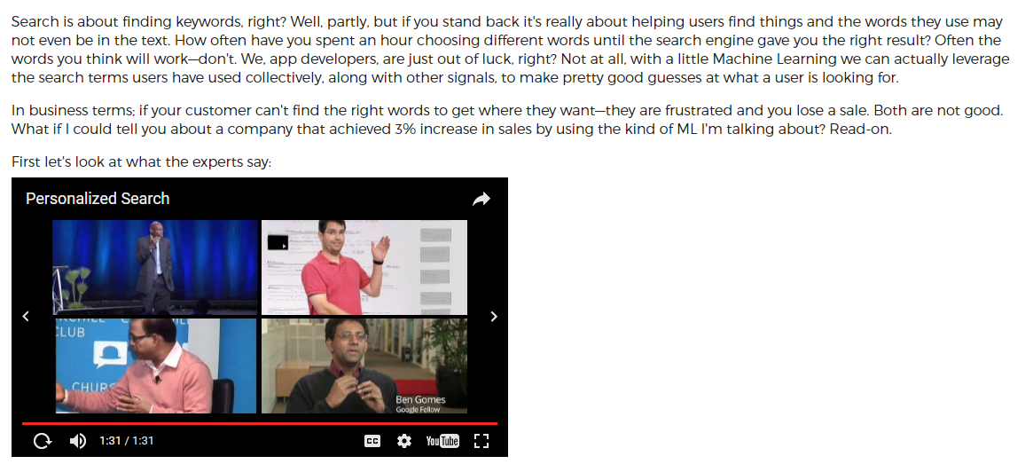
Motivating Example: Personalized Search
http://actionml.com/blog/personalized_search

Slide 11
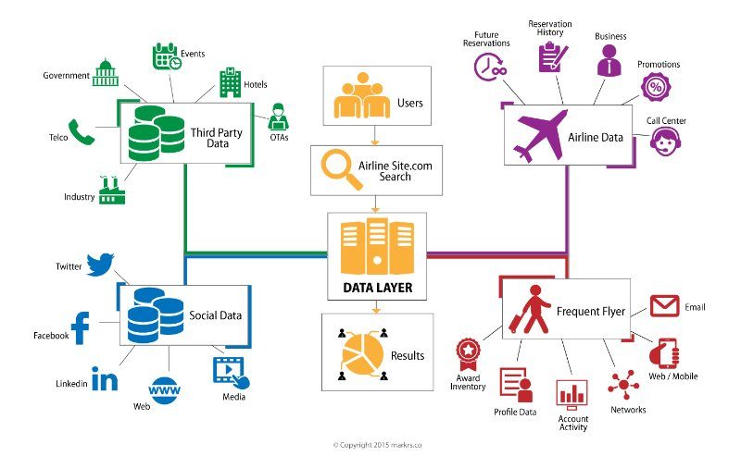
Try as you might… $1000+ for a flight to Super Bowl Feb 4th Motivating Example: Yield Management & Airline Industry
http://www.datasciencecentral.com/profiles/blogs/how-big-data-is-changing-the-way-you-fly

Slide 12
All Complex Systems Follow a Single Evolution
Basic Analytics
Advanced Analytics
Decision Support Systems

Slide 13
DECISION SUPPORT SYSTEMS are built on a foundation of MICRO SERVICES
Each models a specific domain
Small focused ambitions
Think of them as “kitchen appliances”

Slide 14
DECISION SUPPORT SYSTEMS integrate the output of many micro-services using machine learning to automate simple decision making and offer prescriptive guidance for complex decisions…

Slide 15
Micro Service Building Blocks (Algorithms)
Recommender Systems
Regression/Classification (supervised learning)
Clustering (unsupervised learning)
Deep Learning
Network Models
Natural Language Processing (NLP)

Slide 16
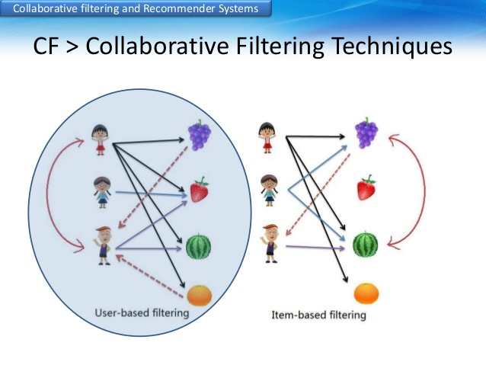
Recommender Systems
Based upon finding suitable measure of either:
User-to-User Similarity
Item-to-Item Similarity

Slide 17
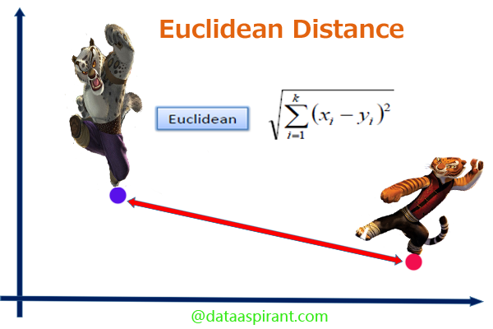
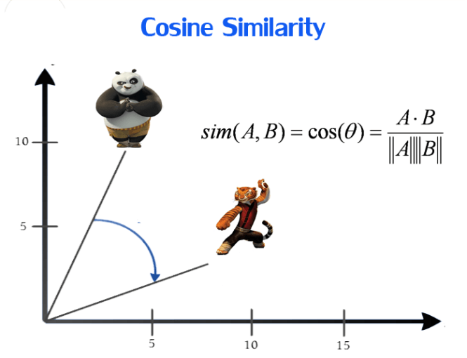
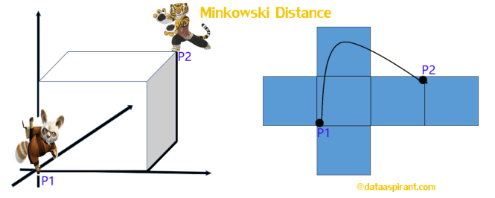
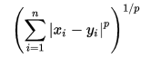
Popular Similarity Measures Continuous
Euclidean:
geo-spatial problems
Minkowski:
Maximum Distance among all item purchases (p=∞)
Minimum Distance among all item purchases (p=∞)
Cosine:
High-Dimensional Consumer “Tastes” in items like proportion of fruit purchases vs cereal
http://dataaspirant.com/2015/04/11/five-most-popular-similarity-measures-implementation-in-python/

Slide 18

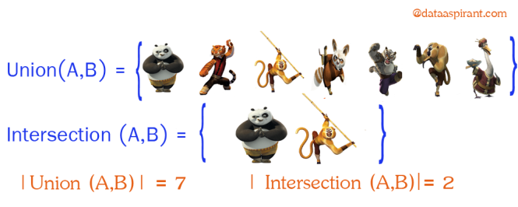
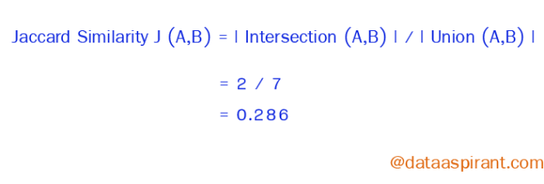

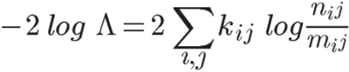
Popular Similarity Measures Discrete
Welcome to Web Data ☺
Jaccard:
Popular measure for over-lapping user behavior or item content
Log Likelihood Ratio:
Classical Statistical Measure of Dependency Between Events
Is there co-occurance more frequent than their prevalence in the population
 | Word A | Not Word A | n_{i+}
Word B | n₁₁ | n₁₂ | n₁₊
Not Word B | n₂₁ | n₂₂ | n₂₊
n+j | n₊₁ | n₊₂ | N
Log Likelihood Ratio
https://www.youtube.com/watch?v=Tn5y2i_MqQ8

Slide 19
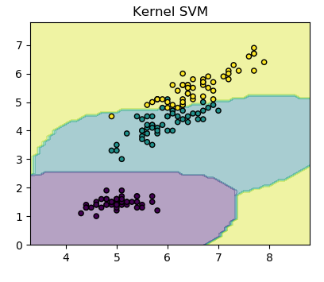
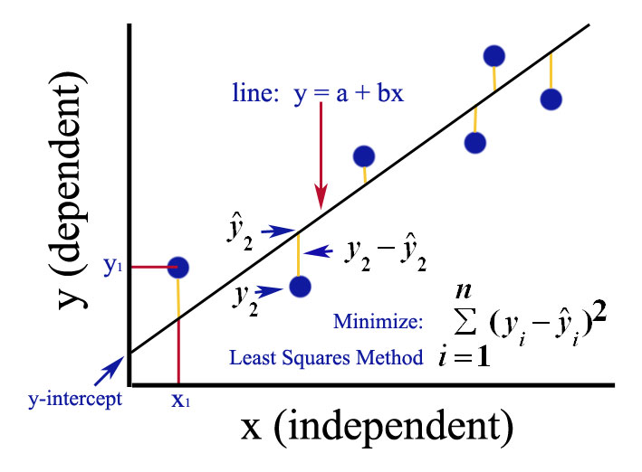
Regression/Classification (supervised learning)
You have defined outcomes and outcome based loss function:
Regression
$ Income vs age
Loss => MSE
Classification
Purchase or Not
Loss => Binomial Likelihood, hinge…

Slide 20
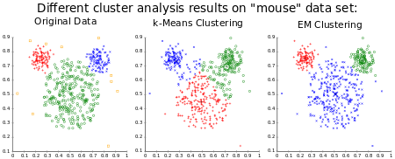
Clustering (Unsupervised Learning)
You lack defined outcomes (Y) and need a similarity measure based solely on predictors (X):
Purity measure based methods
Gaussian Density
K-Means

Slide 21

Deep Learning
You require the machine to learn the feature preparation:
First Principles are Unclear for feature prep
Feature prep is too complicated to explicitly state
High Dimensional Response
http://colah.github.io/posts/2015-08-Understanding-LSTMs/

Slide 22
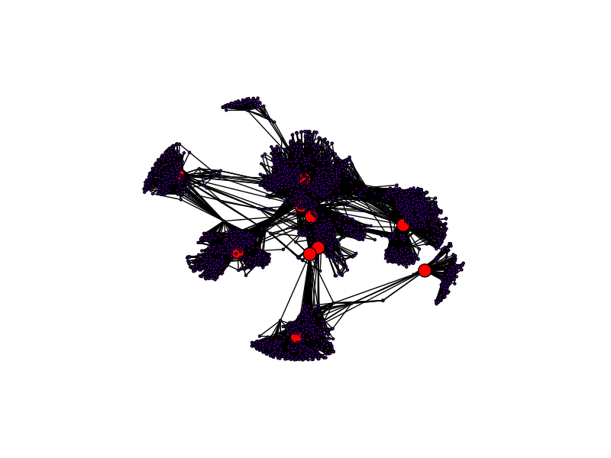
Network Models
Information is contained in a node-edge relationship and its all about connections:
Influencer
Centrality
Community
https://blog.dominodatalab.com/social-network-analysis-with-networkx/

Slide 23
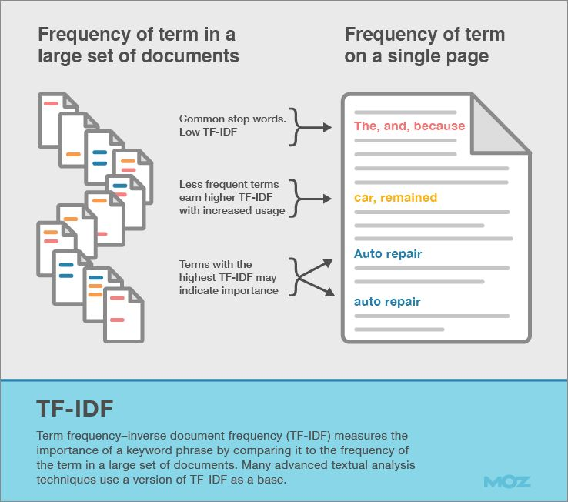
Natural Language Processing (NLP)
Dealing with Text by Clipping to Bag of N-grams:
Tokens
Inverse Document Frequency
Hashing Trick

Slide 24
Agenda
3PLs & CH Robinson
Data Science 101…
Basic Analytics => Decision Support Systems
Team/Roles
Industry Trends
Data Science Strategy & Applications @ CH Robinson
Variety Hour: Working with Twitter API & Streaming

Slide 25


What Defines a Data Scientist?
What is a Data Scientist?
Some Joke that it is a statistician under 35 years of age (I might agree).
Programming
(Spark, Python, R, Scala)
Business Domain
(Know the Market)
Hacker/Engineer
(Linux, OpenSource)
Stats/Math
(Probability theory)

Slide 26
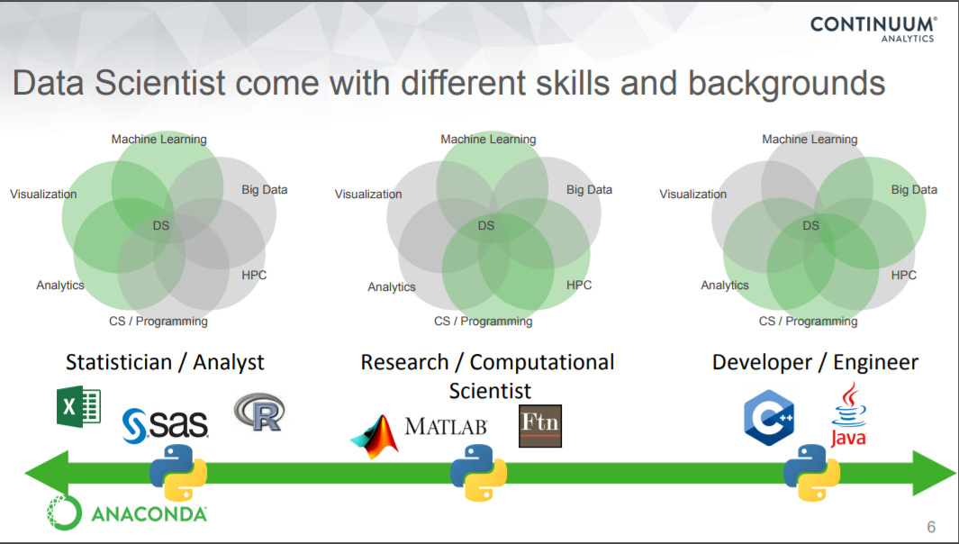

Slide 27
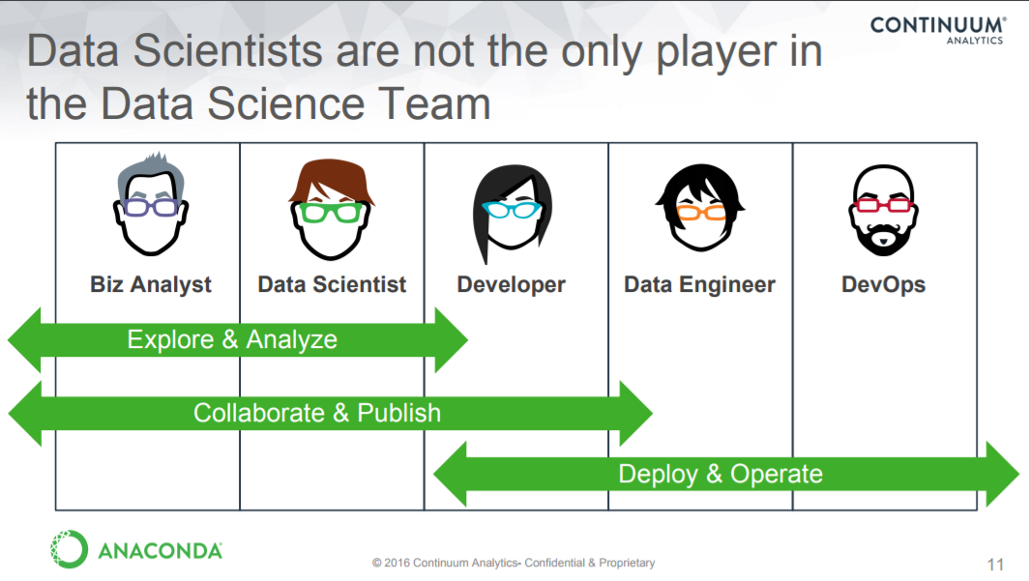

Slide 28
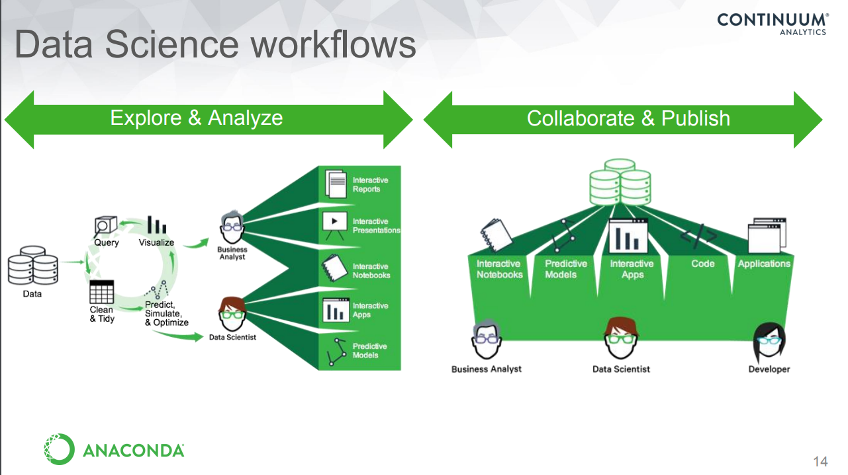
How does this fit with analytics

Slide 29
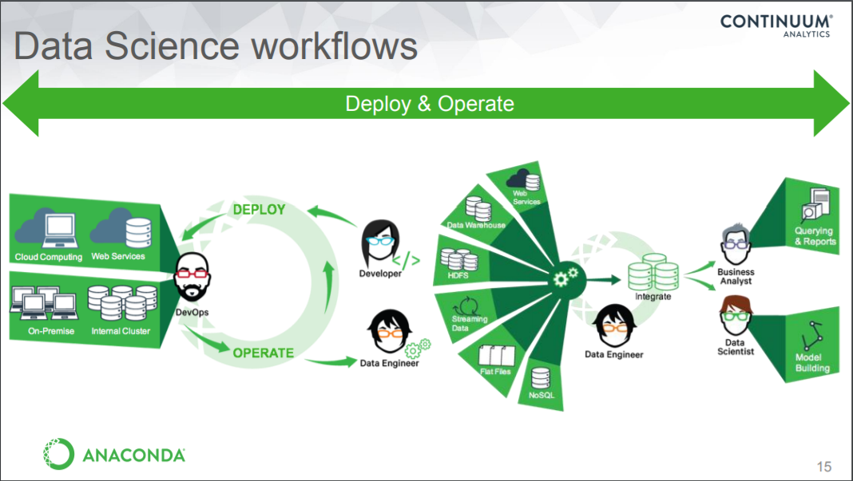

Slide 30
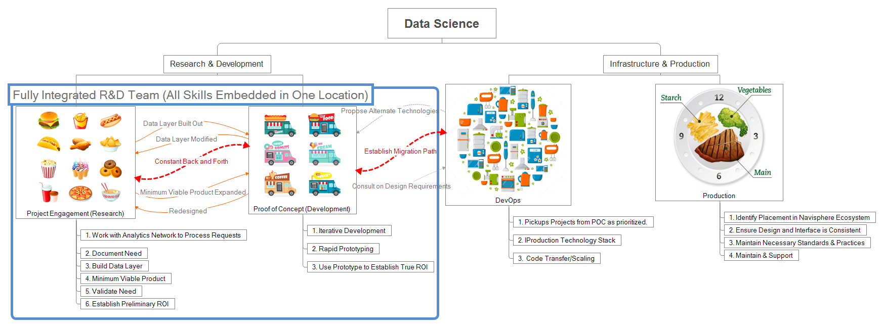
What does the data-product innovation LifeCycle look like?

Slide 31
Lifecycle in Full Detail

Slide 32
Agenda
3PLs & CH Robinson
Data Science 101…
Basic Analytics => Decision Support Systems
Team/Roles
Industry Trends
Data Science Strategy & Applications @ CH Robinson
Variety Hour: Working with Twitter API & Streaming

Slide 33
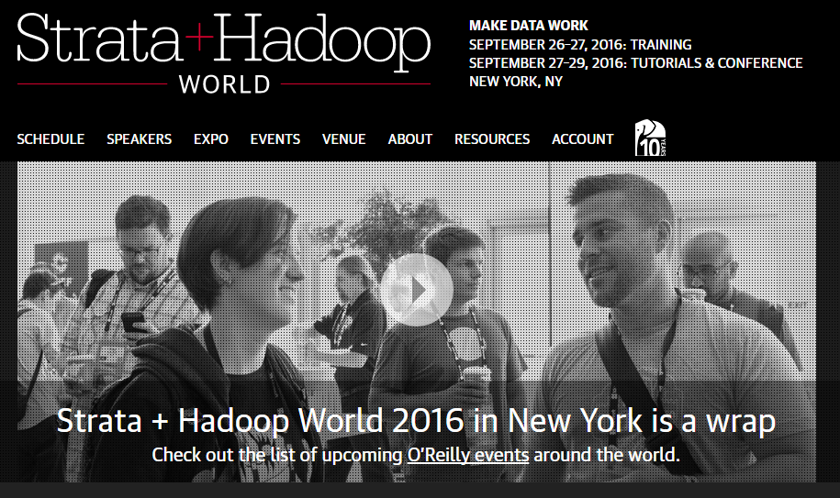
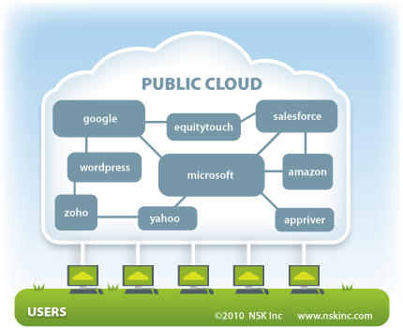
What Trends are Upcoming?
Today 8% of Companies are using Public cloud => 35% in 1 year will have some kind of activity

Slide 34
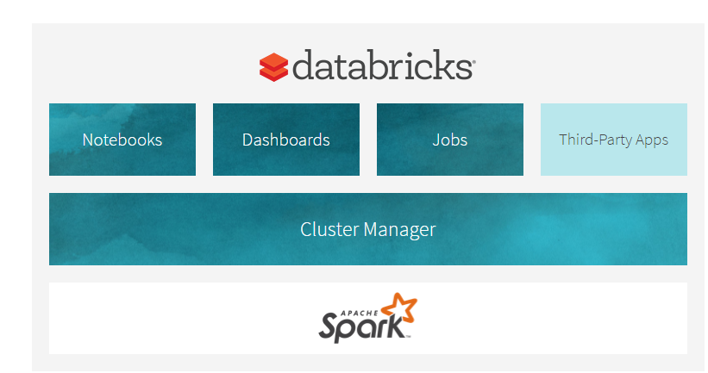
What Trends are Upcoming?
DataBricks is the 800 pound gorilla for spark ecosystem development & public cloud hosting.
Suitable “Cloud First R&D” option
Pennies on the Dollar for Spark Infrastructure (unbelievably cheap)

Slide 35
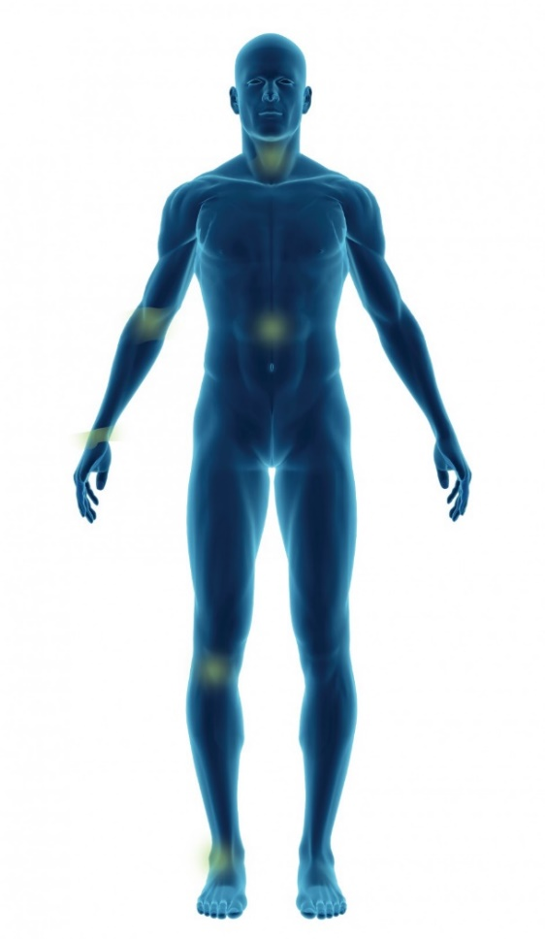
AI and Algorithms working for you versus on you
Artificial Intelligence Bots compete on 2 dimensions:
Best Algorithms
Best Corpus
Present State of Affairs: On You
Recommend products in their best interest (i.e. amazon)
Screen for Credit Worthiness
Fraud Detection
Future State of Affairs: For You
Google desktop mining your emails
Providing appoint reminders
Suggesting responses to emails
Best Algorithms:
Will Go Beyond Mere Feature Extraction (i.e. pattern recognition)
Best Corpus:
Email inbox today, but will evolve with IoT (Internet of things)

Slide 36
Agenda
3PLs & CH Robinson
Data Science 101…
Basic Analytics => Decision Support Systems
Team/Roles
Industry Trends
Data Science Strategy & Applications @ CH Robinson
Variety Hour: Working with Twitter API & Streaming

Slide 37

Remove friction and human interaction from each step of the order to cash cycle
Improve quality and reduce cost to operate.
We will transition tasks, processes and decisions that were once executed manually to automated processes guided by technology and machines.
Why Data Science: Digitalization objective
© 2017 C.H. Robinson Worldwide, Inc. Proprietary and confidential.
Notes:
New technology based competitors
Market getting more competitive – may have secular impacts to margins
Need more efficiency
New competitors like Uber and Amazon
Objective of our digitalization strategy is to remove friction and human interaction from each step of the order to cash cycle while improving quality and reducing cost to operate. We will transition tasks, processes and decisions that were once executed manually to automated processes guided by technology and machines.

Slide 38
Basic Analytics
BREAK GROUND 2016
Acquire Technical Talent
Invest in Big Data Infrastructure (R/Python/Hadoop/Spark/Linux)
Align Strategy and Leadership
Advanced Analytics
BREAK THROUGH 2017
Win Fast with High Probability Initiatives
Develop processes to navigate R&D to Production (DevOps)
Decision Support Systems
BREAK OUT 2018
Data Science and Machine Learning become Core to Strategy
Automate Simple Decision Making
Prescriptive Guidance
ERP Workflows

Slide 39
Basic Challenge: How Do We Evolve and Digitize?
Today
Trading Floor Resembles a “Mechanical Turk”
Systems Makes Raw Events Visible
Manual Touches and Data Gathering required to Execute Transactions
Focus is on:
Individual truck/load opportunities
Short-Term “transactional” gains
Single Load
Single Truck

Slide 40
Basic Challenge: How Do We Evolve and Digitize?
Tomorrow
Goal is to Achieve Basic Digitization
Establish Decision Support Systems:
Optimally match Supply & Demand Networks versus Individual Transactions
Enable Holistic Decision Making
Automate Simple Decisions
Human Interaction occurs at the Strategic Level:
Build Relationships and Plan for Outcomes
Tell the system what to “care about”
Set Strategy, monitor outcomes, and intervene when necessary
AutoPilots
Demand Network
Supply Network

Slide 41
Complex Ambitions require Incremental Value Delivery
Enable Decision Making
TODAY: Research & Develop Micro Services for 3 Critical Problem Domains:
Market Econometrics
Geographic Supply/Demand
Customer/Carrier Behavior

Slide 42
Complex Ambitions require Incremental Value Delivery
Evolve Digitally
TOMORROW: Construct a Digital Matching System that:
Optimizes Trading Floor Yield in Real-Time (i.e. Expected Profit)
Limits transportation disruption for shippers
Ensures high yield in a multi-leg weeklong rotation for carriers

Slide 43
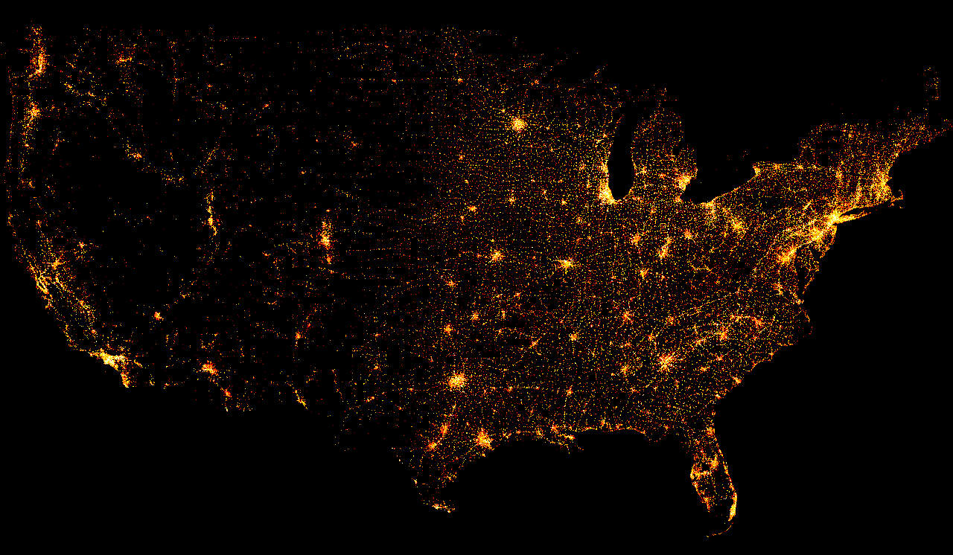
Depth of Our Truckload Data Asset
6 Years 30+ Million Shipments:
50 features per shipment that accurately depict:
Financial Outcomes
Market Capacity & Seasonality
Geospatial Carrier & Customer Networks
650K Companies, 100K presently active
12 million warehouse locations, 4 million active
The rate of mileage driven would take us to the moon and back every 20 minutes!!!

Slide 44
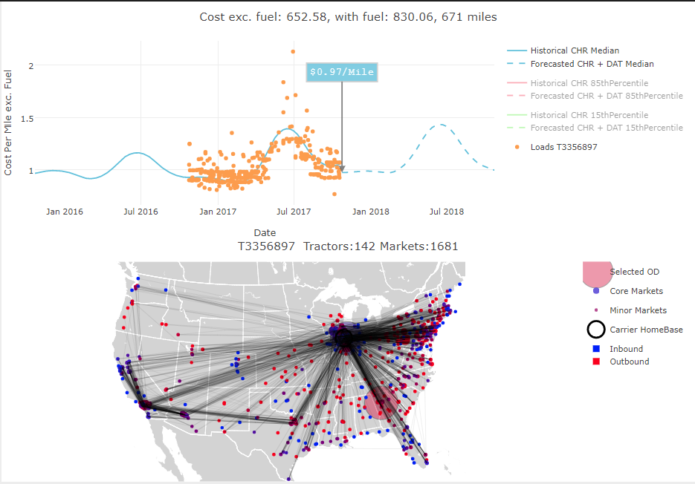
Domain: Customer/Carrier Behavior
Active Research Questions:
How do we Flatten the Tribal Network?
What does a customer/carriers footprint look like?
How do we make this visible to all?
How is Robinson Utilized by Customer/Carrier?
Are we backhaul or network balancing?
Is the freight repeatable or last minute?
In what capacity should this carrier/customer be best utilized in our freight network?
What is the value add Robinson could offer?
Where are inefficiencies only we can see?
What connections would serve better?
How do we educate to improve practices?

Slide 45
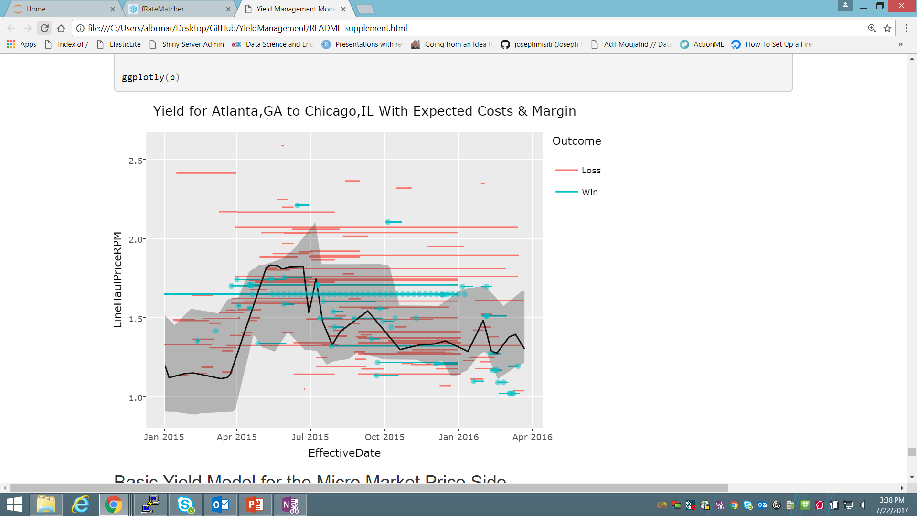
Domain: Market Econometrics
Yield Management
How do we succeed in Reverse Auctions?
Optimize Expected Profit
Price Competitively but Make Money
Take Advantage of Information Asymmetry
How do we plan to source carriers?
Long-term Carrier Contracts vs Spot Market Opportunity => what balance?
Leading Indicator Research
Markets Tip, We Need to Know in Advance
How does buying behavior lag market movement?

Slide 46
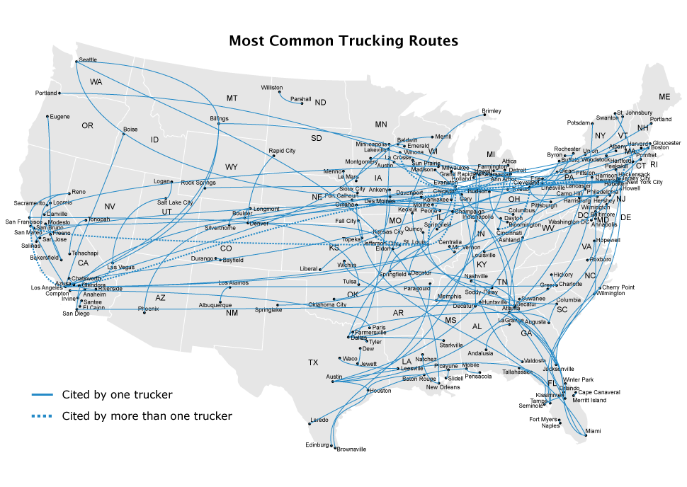
Domain: Network Supply/Demand
Captivate Carrier Fleet Capacity
Model and Execute Advance Carrier Buys
Where do we have reliable future freight?
Reduce exposure to carrier market shifts and shortages
Establish Multi-Leg Weeklong Freight Rotations
Route Optimization and Planning based upon our stochastic load network
Lock carriers into “continuous moves”
Use our Scope and Scale to our Advantage

Slide 47
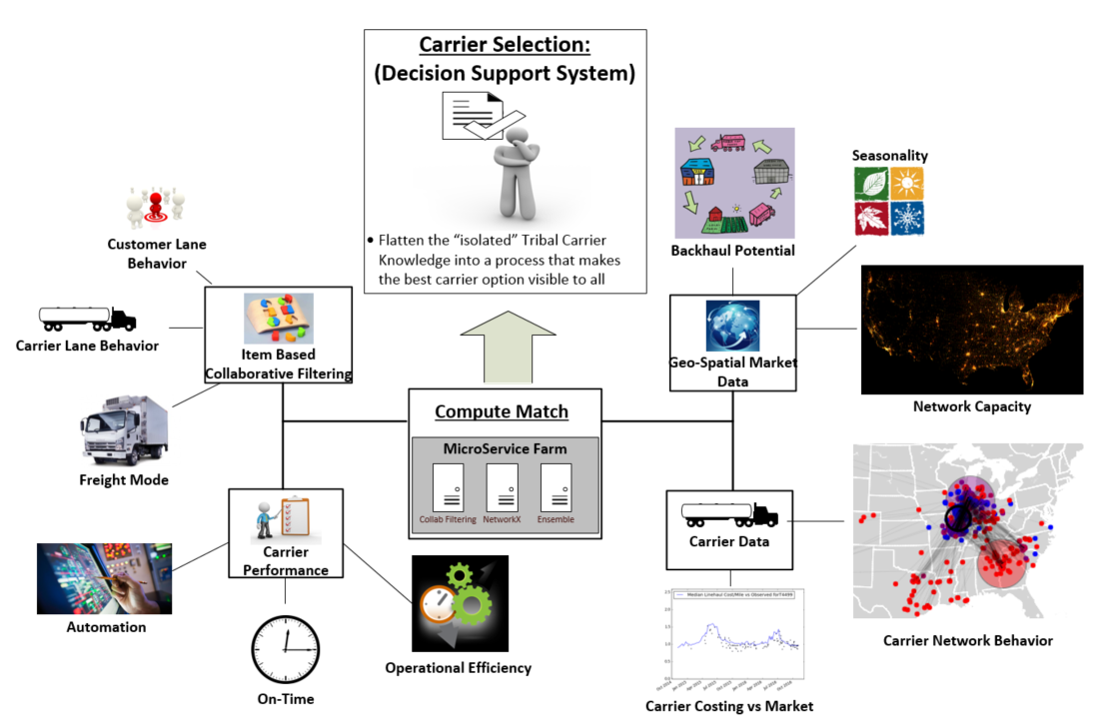
Anatomy of a Basic Decision Support System In Use for Carrier Matching @ CH Robinson

Slide 48
Agenda
3PLs & CH Robinson
Data Science 101…
Basic Analytics => Decision Support Systems
Team/Roles
Industry Trends
Data Science Strategy & Applications @ CH Robinson
Variety Hour: Working with Twitter API & Streaming

